Slide 1
How are you?
A Mental Health Screening Tool

Slide 2
To be designed as a part of
CSE326 Information System Design Project
1705001 - Kowshic Roy
1705002 - Sheikh Azizul Hakim
1705003 - Mahdi Hasnat Siyam
1705008 - Sheikh Saifur Rahman Jony
1705015 - Zaber Ibn Abdul Hakim
1705024 - Khandokar Md Rahat Hossain

Slide 3
“Experiencing trauma is an essential part of being human; history is written in blood.”
Traumatic Stress : The Effects of Overwhelming Experience on Mind, Body, and Society.
(Edited by Bessel A. van der Kolk, Alexander C. Mcfarlane and Lars Weisaeth)

Slide 4
Motivation
70 percent of adults experience at least one traumatic event in their lifetime
20 percent of people who experience a traumatic event will develop PTSD
About 15 million people have PTSD in a given year
PTSD Facts and Statistics | The Recovery Village How Common is PTSD in Adults? - PTSD: National Center for PTSD (va.gov)

Slide 5
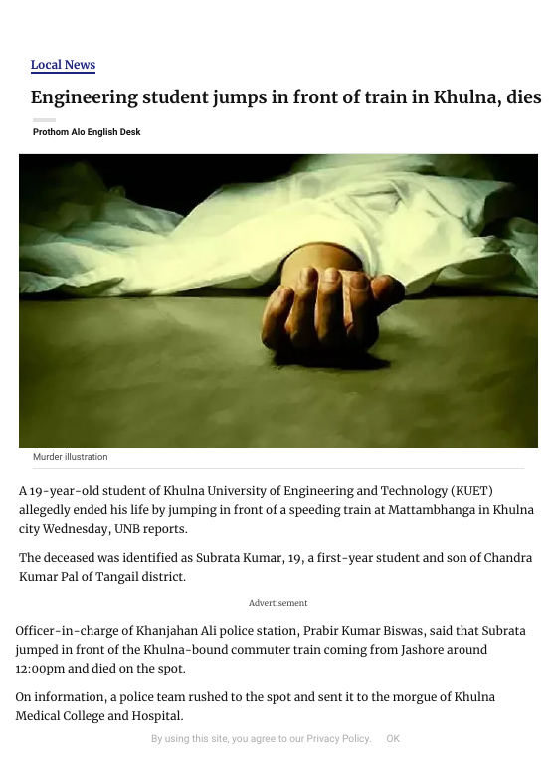
Motivation
https://en.prothomalo.com/bangladesh/local-news/engineering-student-jumps-in-front-of-train-in-khulna-dies

Slide 6
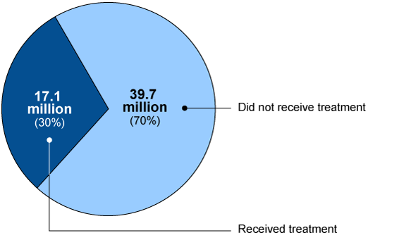
Motivation
￼
https://www.gao.gov/products/gao-19-274

Slide 7
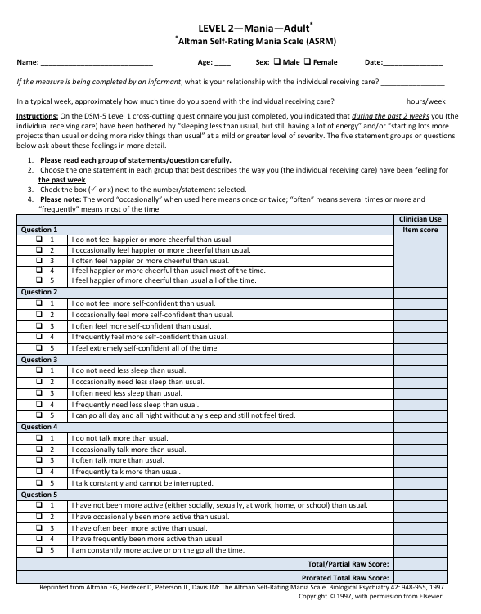
Major Features #1
￼
￼
Automation of questionnaire based mental health diagnosis

Slide 8
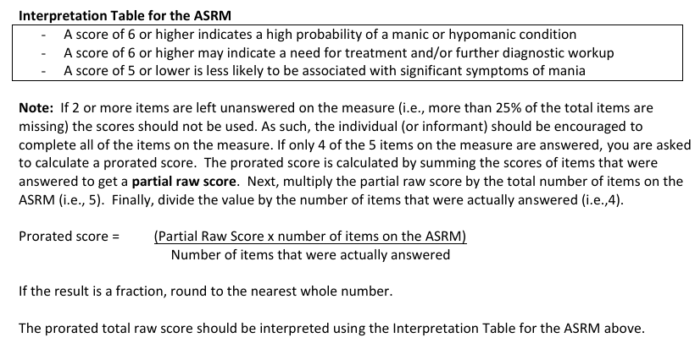
Major Features #2
￼
￼
Report generation and manual verification by psychiatrists

Slide 9
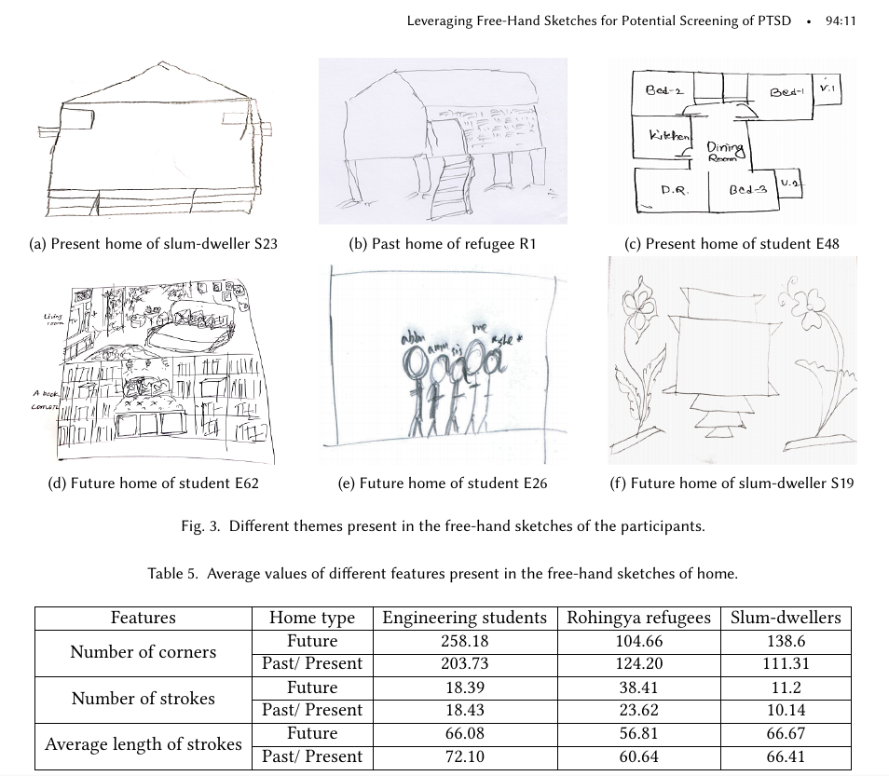
Major Features #3
￼
￼
Collection of data to generate datasets for further research

Slide 10
Modules
Patient
Psychiatrist
Questionnaire
Report & Medication
Data Collection
Disease
Storing detailed information on patients
Monitoring responses and progresses

Slide 11
Modules
Patient
Psychiatrist
Questionnaire
Report & Medication
Data Collection
Disease
Examining patients and suggesting appropriate Q/A
Crosscheking reports
Prescribing medications

Slide 12
Modules
Patient
Psychiatrist
Questionnaire
Report & Medication
Data Collection
Disease
Storing the DSM-5 Questionnaire
Implementing the underlying diagnosis strategy

Slide 13
Modules
Patient
Psychiatrist
Questionnaire
Report & Medication
Data Collection
Disease
A helper module for psychiatrists
Can be useful to generate case studies

Slide 14
Modules
Patient
Psychiatrist
Questionnaire
Report & Medication
Data Collection
Disease
Receiving files from patients as recommended by psychiatrists
Generating datasets
Special emphasis on privacy and freedom and choice

Slide 15
Modules
Patient
Psychiatrist
Questionnaire
Report & Medication
Data Collection
Disease
Shows a short description and recent trends of mental health disorders, available for public use

Slide 16
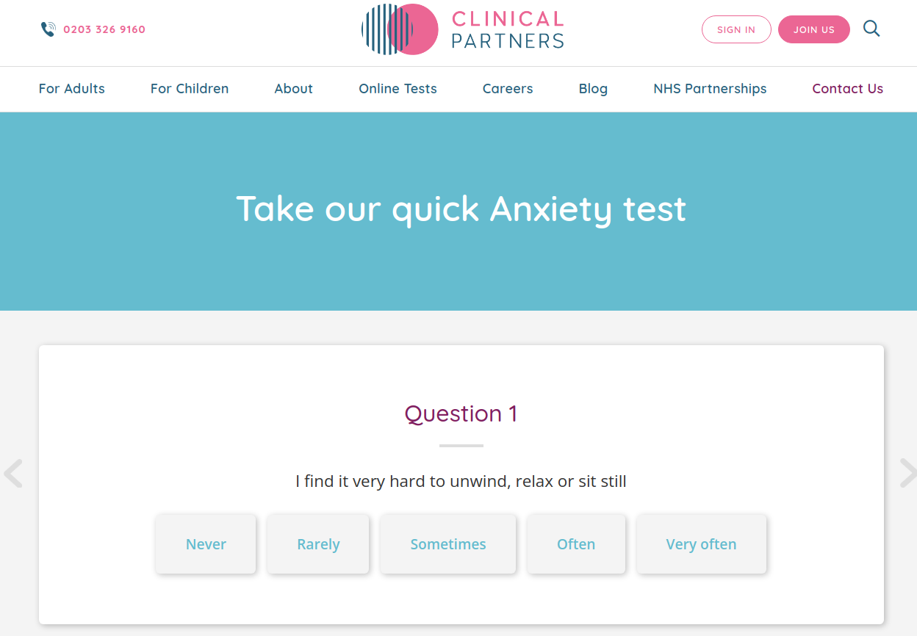
Existing Examples
https://www.clinical-partners.co.uk/for-adults/anxiety-disorders/anxiety-test

Slide 17
Dataset Generation
The questionnaires are standardized by the American Psychiatric Association (APA) and readily available online.
The questionnaires will be reviewed by professional psychiatrists to stay up-to-date and if needs be, culturally and linguistically relevant.
Furthermore, the user can upload files which can be associated with the aforementioned diagnosis and can be used to extract valuable insights from their data.

Slide 18
Distribution of the upcoming presentations
Requirements Analysis with BPMN Diagrams | 1705015
Mock UI | 1705024
Class Diagrams (and ER Diagrams) | 1705008, 1705003
State Diagrams (and Interaction Diagrams) | 1705001, 1705002
Partial Software Demo | all

Slide 19
Thank you all.

